Slide 1
Prolog and declarative programming
10/13/2017

Slide 2
Declarative programming
Logic programming languages are fundamentally different from imperative programming languages.
State “this is true about the result”, not “this is how to compute the result”
Encode a knowledge base
Interact with the knowledge base through queries
The underlying inference engine will attempt to answer your queries
It works by building constructive proofs that your queries are entailed by the knowledge base

Slide 3
Prolog
Programmation en logique (“Programming in logic”)
Alain Colmeraeur & Philippe Roussel, 1971-1973
With help from theorem proving folks such as Robert Kowalski
Original project: Type in French statements & questions
Computer needed NLP and deductive reasoning
Efficiency by David Warren, 1977 (compiler, virtual machine)
One of the foundations of early efforts in AI
Prolog favored by the European AI community
LISP favored by the American AI community

Slide 4
Applications of Prolog
Intelligent database retrieval
Natural language processing
Expert systems
Ontologies
Theorem proving
Robot planning
Automated reasoning / problem solving
Artificial intelligence

Slide 5
Prolog in one slide
Everything in Prolog is built from terms.
Three kinds of terms:
Constants: integers, real numbers, atoms
Variables
Compound terms
A Prolog language system maintains a collection of facts and rules of inference
A Prolog program is just a set of rules for this rule base
The simplest kind of thing in the rule base is a fact: a term followed by a period

Slide 6
Helpful tutorials
http://www.cs.toronto.edu/~sheila/324/f05/tuts/swi.pdf
https://www.cpp.edu/~jrfisher/www/prolog_tutorial/contents.html#1

Slide 7
is_a( socrates, human ).
is_a( X, mortal ) :- is_a( X, human ).

Slide 8
Knowledge base
Queries
is_a( socrates, human ).
is_a( X, mortal ) :- is_a( X, human ).
> is_a( socrates, mortal ).
true .
> is_a( socrates, human ).
true .
> is_a( Person, human ).
Person = socrates .
> is_a( Person, mortal ).
Person = socrates .

Slide 9
Knowledge base
Queries
factorial(0,1).
factorial(A,B) :-
A > 0,
C is A-1,
factorial(C,D)
B is A*D.
> factorial(10, What).
What=3628800

Slide 10
Knowledge base
Queries
borders( belgium, france ).
borders( france, spain ).
borders( germany, austria ).
borders( germany, denmark ).
borders( germany, switzerland ).
borders( netherlands, belgium ).
borders( netherlands, germany ).
borders( spain, portugal ).
route( A, B ) :-
borders( A, B ).
route( A, B ) :-
borders( A, Z ),
route( Z, B ).
> route(netherlands,portugal).
true .

Slide 11
Knowledge base
Queries
...
route( A, B, [ go(A,B) ] ) :-
borders( A, B ).
route( A, B, [ go(A,Z) | ZtoB ] ) :-
borders( A, Z ),
route( Z, B, ZtoB ).
> route(netherlands,portugal,R).
R = [go(netherlands, belgium),
go(belgium, france),
go(france, spain),
go(spain, portugal)]

Slide 12
Knowledge base
Queries
tidy( [], [] ).
tidy( [ Toy | OtherToys ],
[ pick_up(Toy),
move_to(toybox),
drop(Toy) | OtherCommands ] ) :-
tidy( OtherToys, OtherCommands ).
> tidy( [ teddy, ball, golly, bat ], Cmds ).
Cmds = [ pick_up(teddy),
move_to(toybox),
drop(teddy),
pick_up(ball),
move_to(toybox),
drop(ball),
pick_up(golly),
move_to(toybox),
drop(golly),
pick_up(bat),
move_to(toybox),
drop(bat)]
“This is how to tidy up your room: if there are no toys lying around, do nothing. if there is a toy lying around, pick it up and put it in the toybox, and tidy up your room.” - Patrick Winston

Slide 13
Knowledge base
Queries
mother_child(trude, sally).
father_child(tom, sally).
father_child(tom, erica).
father_child(mike, tom).
sibling(X, Y) :- parent_child(Z, X), parent_child(Z, Y).
parent_child(X, Y) :- father_child(X, Y).
parent_child(X, Y) :- mother_child(X, Y).
> sibling(sally, erica).
true
> parent_child(Parent, erica),
parent_child(Parent, sally).
Parent = tom
> parent_child(Parent, Child).
Parent = tom,
Child = sally
Parent = tom,
Child = erica
Parent = mike,
Child = tom
Parent = trude,
Child = sally.

Slide 14
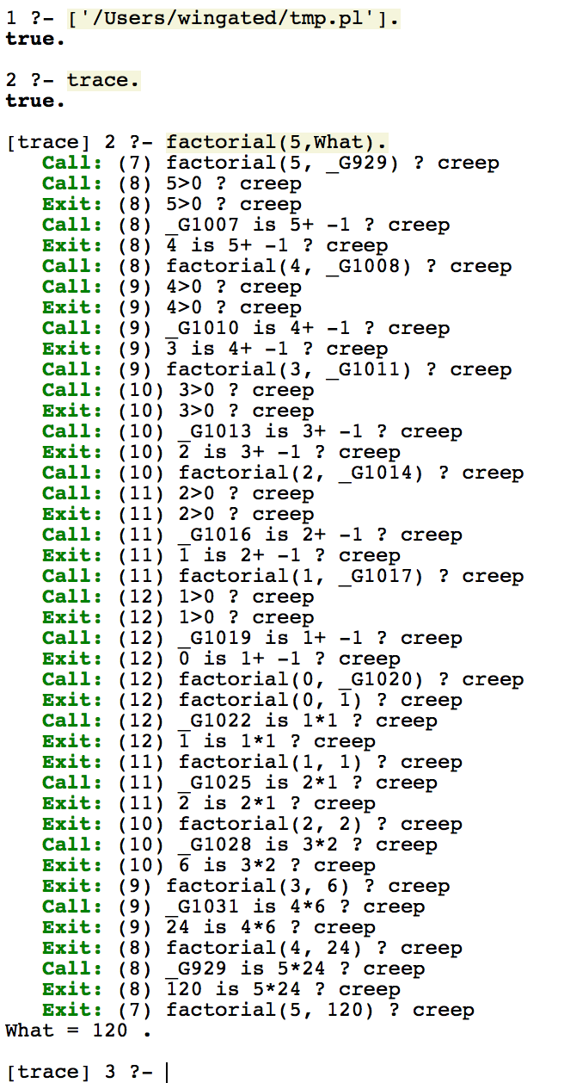
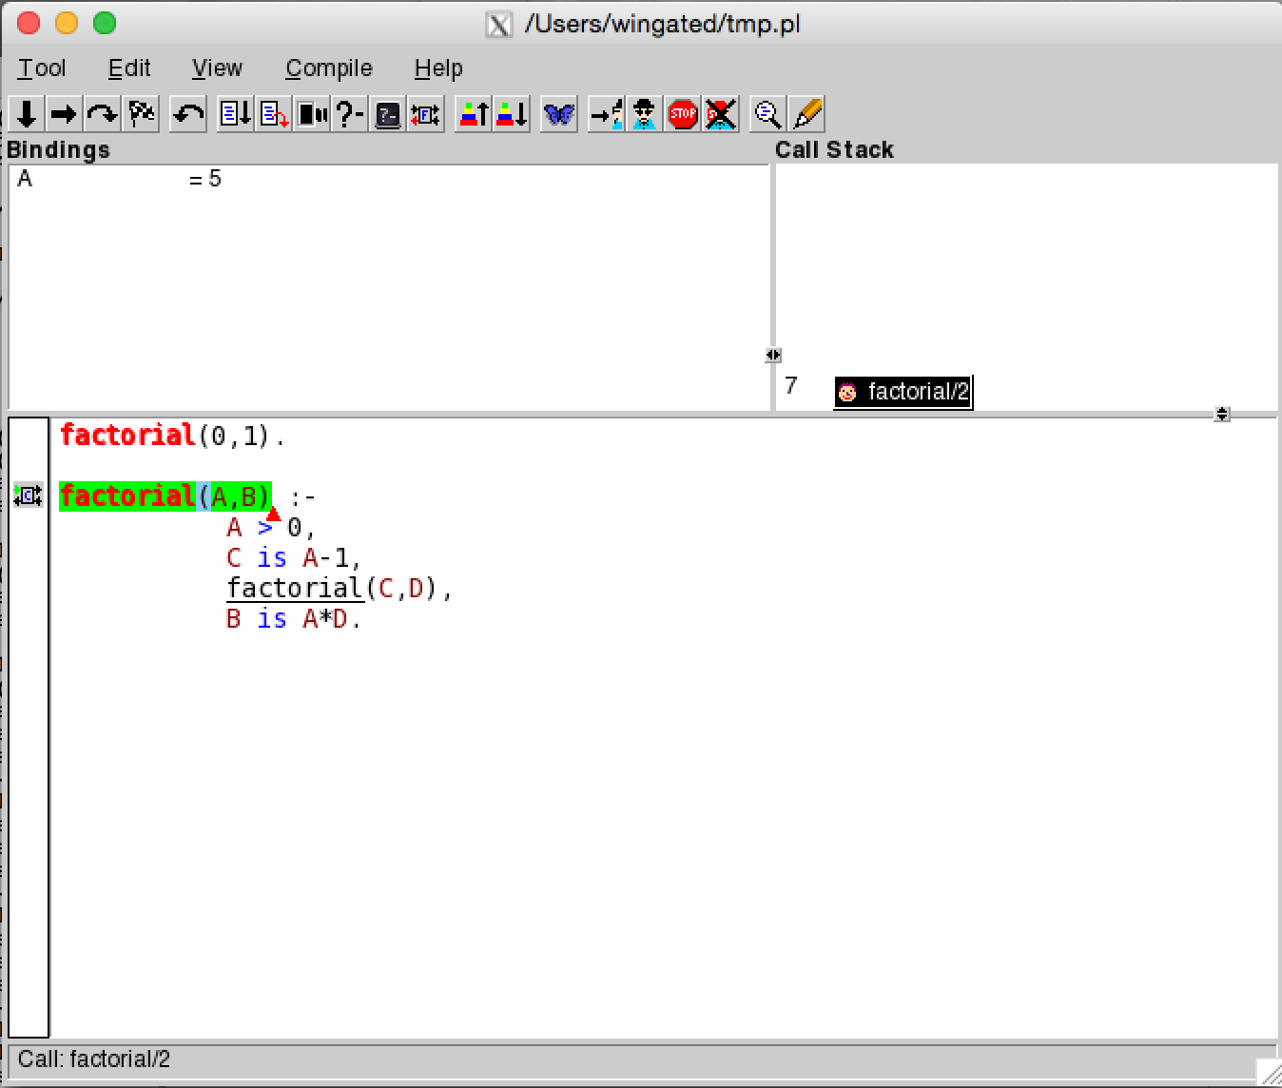
Debugging
Can use trace. or notrace. to trace execution. (see tutorials)
Also check out spy (like a breakpoint)

